Slide 1
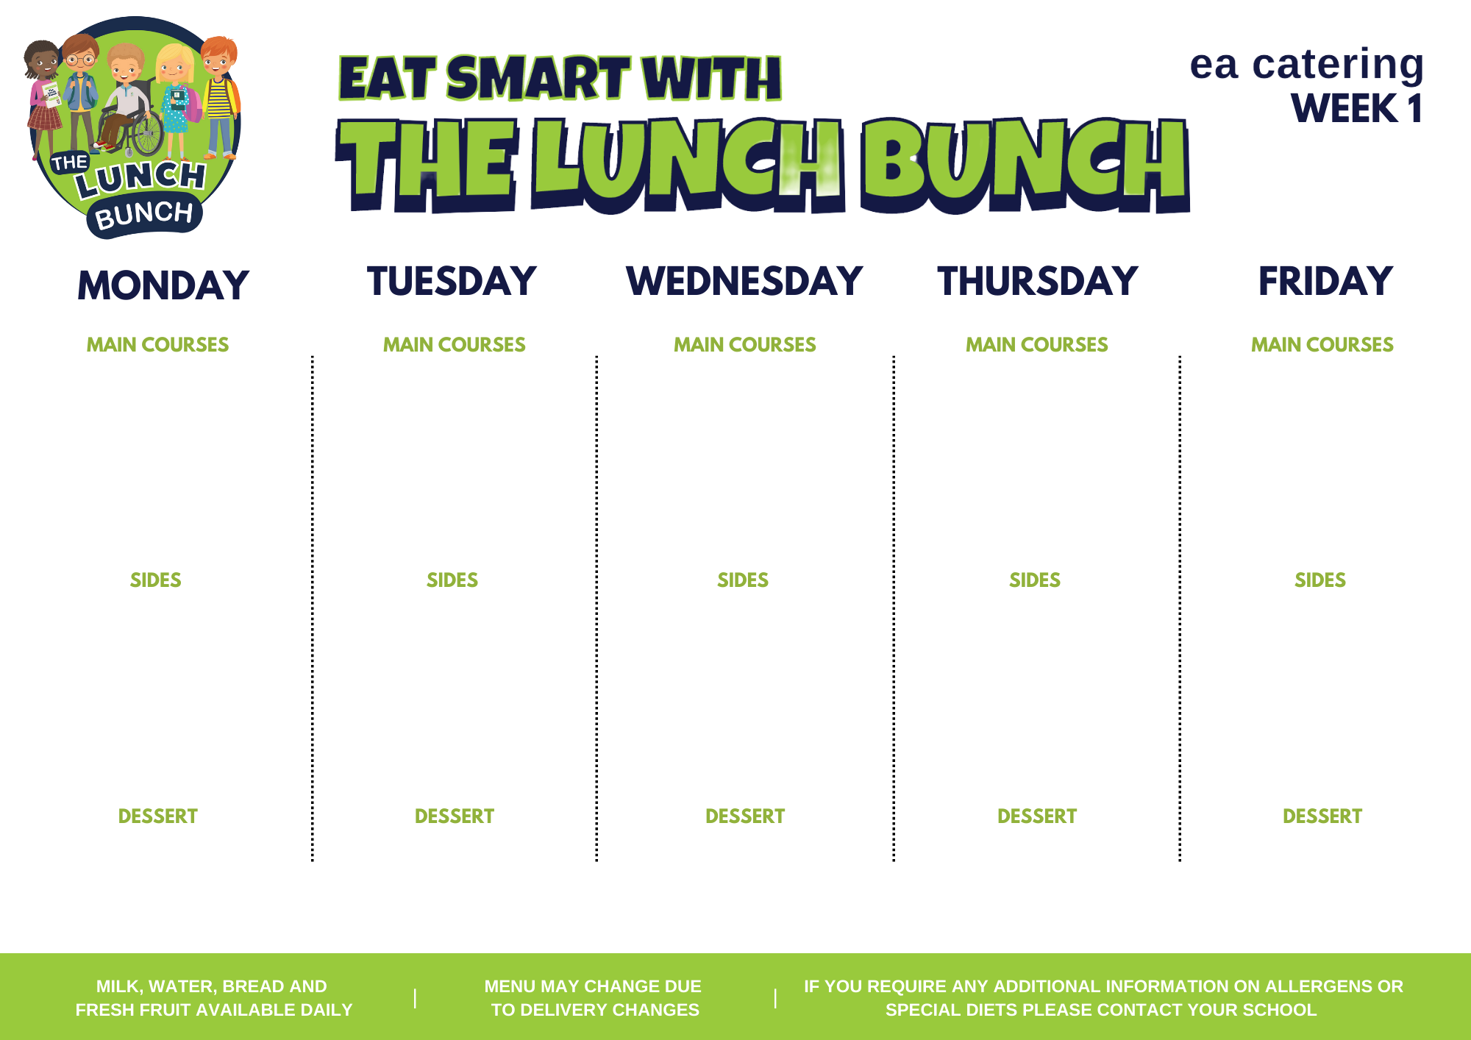
Week commencing
Aug 28, Sept 25, Oct 23, Nov 20, Dec 18, Jan 22
Classic Margherita Pizza
Savoury Mince
Roast of the Day
Lunch Bunch Chicken Curry & Naan Bread
Hot Dog with Tomato Ketchup
Salad/Coleslaw
Chipped Potatoes/ Baked Potato
Baton Carrot
Mashed Potatoes or Pasta
Carrots & Parsnip/Savoy Cabbage
Mashed Potatoes/Oven Roast Potato
Garden Peas/Sweetcorn
Steamed Rice
Baked Beans/Salad
Chipped Potatoes/Baked Potato
Strawberry Mousse & Fruit
Banana Yoghurt Pot
Strawberry Jelly, Ice Cream & Fruit
Chocolate Sponge & Custard
Fresh Fruit Pot & Biscuit

Slide 2
WEEK COMMENCING:
SEP 04, OCT 02, OCT 30, NOV 27, JAN 01, JAN 29
Sausage Roll
Pasta Bolognaise with Garlic Bread
Roast of the Day with Stuffing & Gravy
Or
Poached Salmon
Lunch Bunch Chicken Curry & Naan Bread
Beef Burger in a Bap with Tomato Ketchup
Spaghetti Hoops & Garden Peas
Chipped Potatoes/Jacket Potato
Sweetcorn/Salad
Homemade Diced Potatoes
Cauliflower/Broccoli/ Carrots
Mashed Potatoes/Oven Roasted Potato
Garden Peas
Steamed Rice
Tossed Salad
Chipped Potatoes/Mashed Potatoes
Ice Cream, Chocolate Sauce and Sliced Pears
Zesty Orange Sponge & Custard
Blueberry Muffin
Fresh Fruit Salad and Yoghurt
Flakemeal Biscuit & Fruit

Slide 3
WEEK COMMENCING: SEP 11, OCT 9, NOV 6,
DEC 4, JAN 8, FEB 5
Golden Crumbed Fish Fingers
Italian Beef with Crusty Roll
Roast of the Day
Lunch Bunch Chicken Curry & Naan Bread
Tasty Pork Sausages with Tomato Ketchup/Gravy
Baked Beans/Coleslaw
Chipped Potatoes/Mashed Potatoes
Garden Peas/Salad/Oven Roast
Diced Potatoes
Carrot & Parsnip/Cauliflower Cheese
Mashed Potatoes/Oven Roast Potato
Mini Corn on the Cob
Steamed Rice
Peas/Spaghetti Hoops
Chipped Potatoes/Mashed Potatoes
Artic Roll with Peaches & Pears
Fresh Fruit Pot
Melon Wedge
Lemon Drizzle Cake & Custard
Decorated Fairy Cake

Slide 4
WEEK COMMENCING:
SEP 18, OCT 16, NOV 13,
DEC 11, JAN 15, FEB 12
Ham & Cheese Pizza or Pepperoni with Garlic Dip
Beef Bolognaise with Spaghetti or Pasta Twists & Garlic Bread
Roast of the Day
Lunch Bunch Chicken Curry & Naan Bread
Golden Crumb Fish Fingers
Sweetcorn and Red Pepper/Coleslaw
Chipped Potatoes/Baked Potato
Peas
Broccoli/Turnip
Mashed Potatoes/Oven Roast Potato
Green Beans
Steamed Rice
Salad/Baked Beans
Chipped Potatoes/Mashed Potatoes
Jelly & Mandarin Oranges
Melon, Mandarin & Pineapple Pots with Yoghurt Dip
Ice Cream, Pears & Chocolate Sauce
Cornflake Tart & Custard
Homemade Ginger Biscuit and Fruit

Slide 5
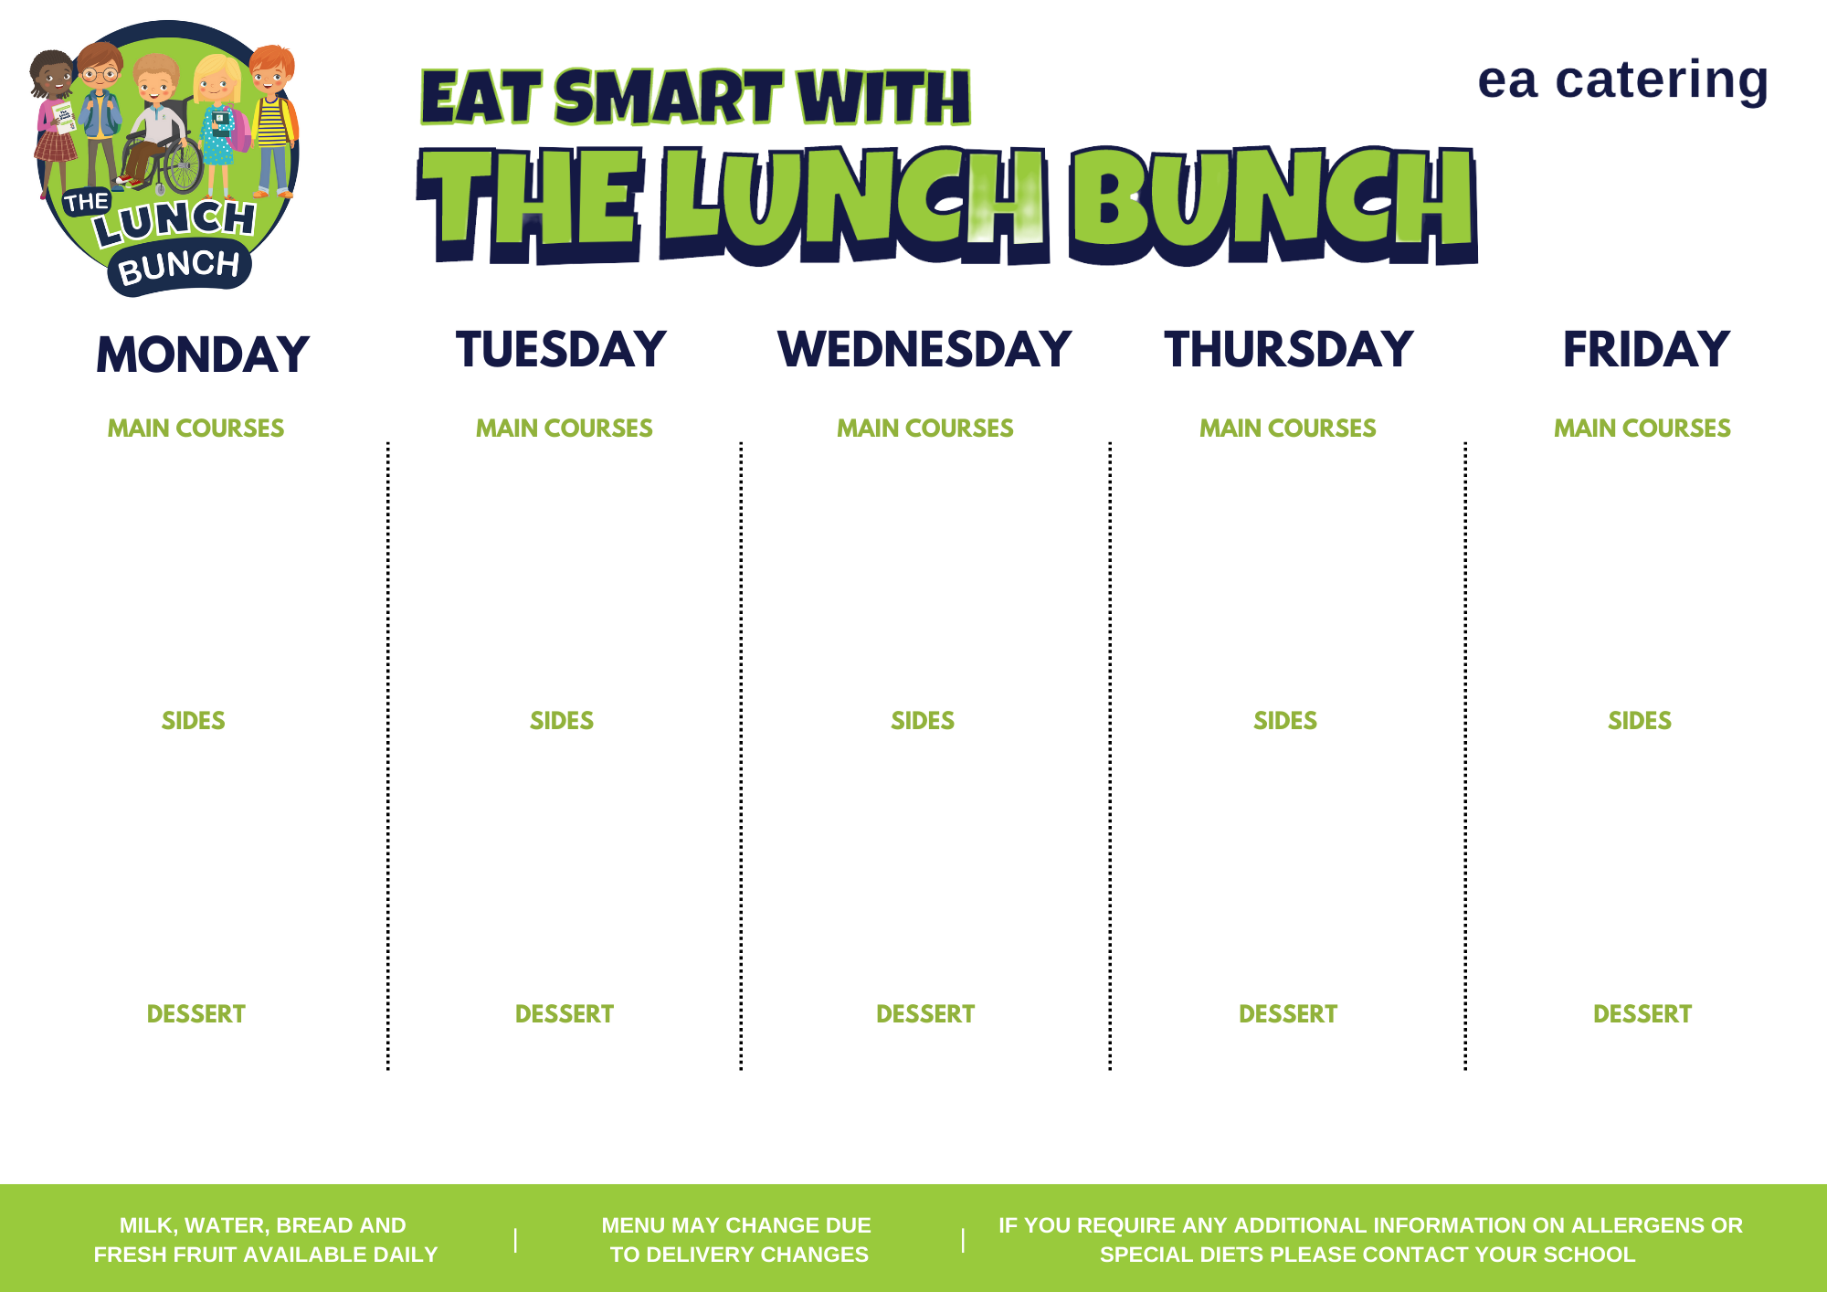
Week xxx
Week Commencing:
XXxx xx
Xxxxxxxxxxxxxxxxxxx
Xxxxxxxxxxxxxxxxxxx
Or
Xxxxxxxxxxxxxxxxxxx
xxxxxxxxxxxxxxxxxxx
Xxxxxxxxxxxxxxxxxxx
Xxxxxxxxxxxxxxxxxxx
Or
Xxxxxxxxxxxxxxxxxxx
xxxxxxxxxxxxxxxxxxx
Xxxxxxxxxxxxxxxxxxx
Xxxxxxxxxxxxxxxxxxx
Or
Xxxxxxxxxxxxxxxxxxx
xxxxxxxxxxxxxxxxxxx
Xxxxxxxxxxxxxxxxxxx
Xxxxxxxxxxxxxxxxxxx
Or
Xxxxxxxxxxxxxxxxxxx
xxxxxxxxxxxxxxxxxxx
Xxxxxxxxxxxxxxxxxxx
Xxxxxxxxxxxxxxxxxxx
Or
Xxxxxxxxxxxxxxxxxxx
xxxxxxxxxxxxxxxxxxx
Xxxxxxxxxxxxxxxxxxx
Xxxxxxxxxxxxxxxxxxx
and
Xxxxxxxxxxxxxxxxxxx
xxxxxxxxxxxxxxxxxxx
Xxxxxxxxxxxxxxxxxxx
Xxxxxxxxxxxxxxxxxxx
and
Xxxxxxxxxxxxxxxxxxx
xxxxxxxxxxxxxxxxxxx
Xxxxxxxxxxxxxxxxxxx
Xxxxxxxxxxxxxxxxxxx
and
Xxxxxxxxxxxxxxxxxxx
xxxxxxxxxxxxxxxxxxx
Xxxxxxxxxxxxxxxxxxx
Xxxxxxxxxxxxxxxxxxx
and
Xxxxxxxxxxxxxxxxxxx
xxxxxxxxxxxxxxxxxxx
Xxxxxxxxxxxxxxxxxxx
Xxxxxxxxxxxxxxxxxxx
and
Xxxxxxxxxxxxxxxxxxx
xxxxxxxxxxxxxxxxxxx
Xxxxxxxxxxxxxxxxxxx
Xxxxxxxxxxxxxxxxxxx
Xxxxxxxxxxxxxxxxxxx
Xxxxxxxxxxxxxxxxxxx
Xxxxxxxxxxxxxxxxxxx
Xxxxxxxxxxxxxxxxxxx
Xxxxxxxxxxxxxxxxxxx
Xxxxxxxxxxxxxxxxxxx
Xxxxxxxxxxxxxxxxxxx
Xxxxxxxxxxxxxxxxxxx

